Slide 1
Project Report 2
Team Ehrgo Health
04/10/16
Notes:
This template can be used as a starter file to give updates for project milestones.
Sections
Right-click on a slide to add sections. Sections can help to organize your slides or facilitate collaboration between multiple authors.
Notes
Use the Notes section for delivery notes or to provide additional details for the audience. View these notes in Presentation View during your presentation.
Keep in mind the font size (important for accessibility, visibility, videotaping, and online production)
Coordinated colors
Pay particular attention to the graphs, charts, and text boxes.
Consider that attendees will print in black and white or grayscale. Run a test print to make sure your colors work when printed in pure black and white and grayscale.
Graphics, tables, and graphs
Keep it simple: If possible, use consistent, non-distracting styles and colors.
Label all graphs and tables.

Slide 2

Project Overview
Plugin architecture to capture treatment analysis from EHR
Patient Portal: allowing patient to enter personal information and leverage commonly-used technology APIs such as MyFitnessPal
Provider EHR plugin: show warnings between allergies/medication and optimize treatment strategies
Notes:
What is the project about?
Define the goal of this project
Is it similar to projects in the past or is it a new effort?
Define the scope of this project
Is it an independent project or is it related to other projects?
* Note that this slide is not necessary for weekly status meetings

Slide 3
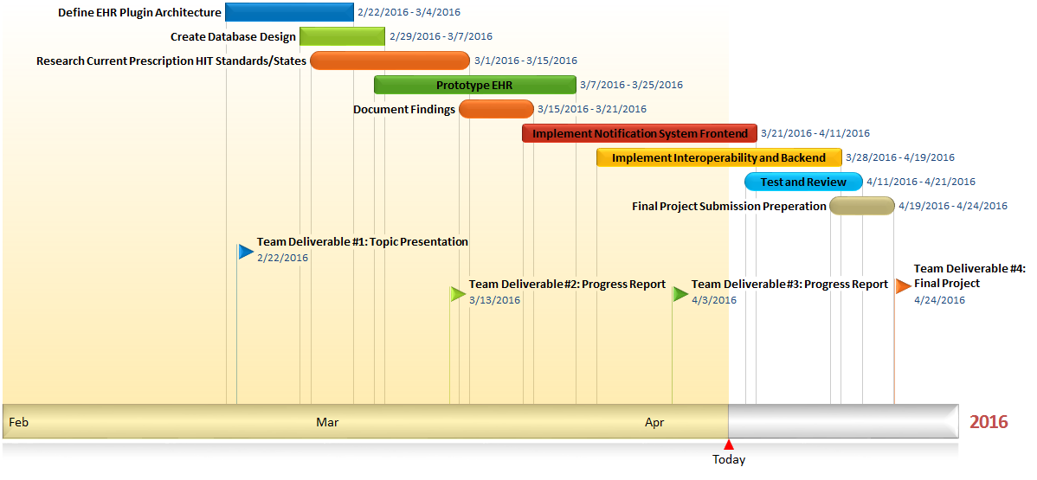
Progress Chart

Slide 4

Current Status and Screenshots
Progress made from previous milestone (Show code or screenshots for each of these)
Defined Target Platforms and Data Interop
Completed EHR Prototype used to test provider snap-in capability
Defined set of Project Risks and Capabilities
Problem Item(s) List captured using Github Issues tracker
75% Complete full stack development
Notes:
* If any of these issues caused a schedule delay or need to be discussed further, include details in next slide.

Slide 5
Further Research

Slide 6
Ehrgo Health Team Members
Eric Greene: Project Manager/Developer
Huarui Zheng: Developer/Tester Narrator
Donna Carey: Documentation Lead/Developer
Tommy Parnell: Development Lead/Documentation
James Ruiz: Developer/Tester
Notes:
Prepare slides for the appendix in the event that more details or supplemental slides are needed. The appendix is also useful if the presentation is distributed later.

